Slide 1
Point & Figure Analysis
A Disciplined Approach to Investing in the Stock Market
The Company fundamentals looks great. All the analysts love it.
So why is the stock going down?
Notes:
Can anybody here relate to this feeling? The company fundamentals look great. All the analysts love the stock, but it just keeps going down! Has anybody here bought stock in a good company and felt puzzled when the stock went down?

Slide 2

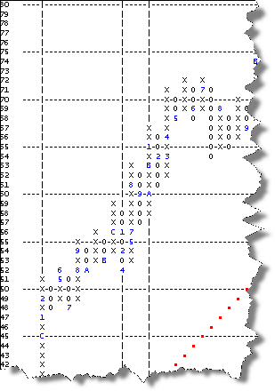
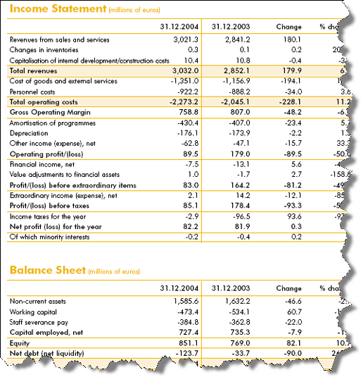
Fundamental Analysis vs. Technical Analysis
What is Fundamental Analysis?
What is Technical Analysis?
What to Buy
Company Management
Earnings Quality
Price/Earnings Ratio
Product Acceptance
When to Buy
Trend Analysis
Relative Strength
Momentum
When to Sell
Notes:
Basically, there are two types of securities analysis – fundamental analysis and technical analysis. Fundamental analysis is what most of us are familiar with. When you see an analyst on television or read comments from an analyst in a magazine or news story, most often these comments come from fundamental analysts.
A fundamental analyst tries to answer the question “What” to buy. She will study the company’s balance sheet, evaluate the management team, try to understand the quality of the company’s earnings.
A technical analyst tries to answer the question “When” to buy and just as importantly, “When” to sell. A technical analyst wants to find the trend of a chart – is it trending up or trending down? Is the stock outperforming the broad market? How high, or in some cases, how low can the stock go?
Unfortunately, there are very few on Wall Street who effectively combine the fundamentals with the technicals. In a sense, they’re playing the piano with only one had. While that may be a way to play a simple melody, you can play much better music if you play the piano with both hands. In fact, our game plan is grounded in this philosophy of combining the fundamentals with the technicals, or playing the piano with both hands.

Slide 3
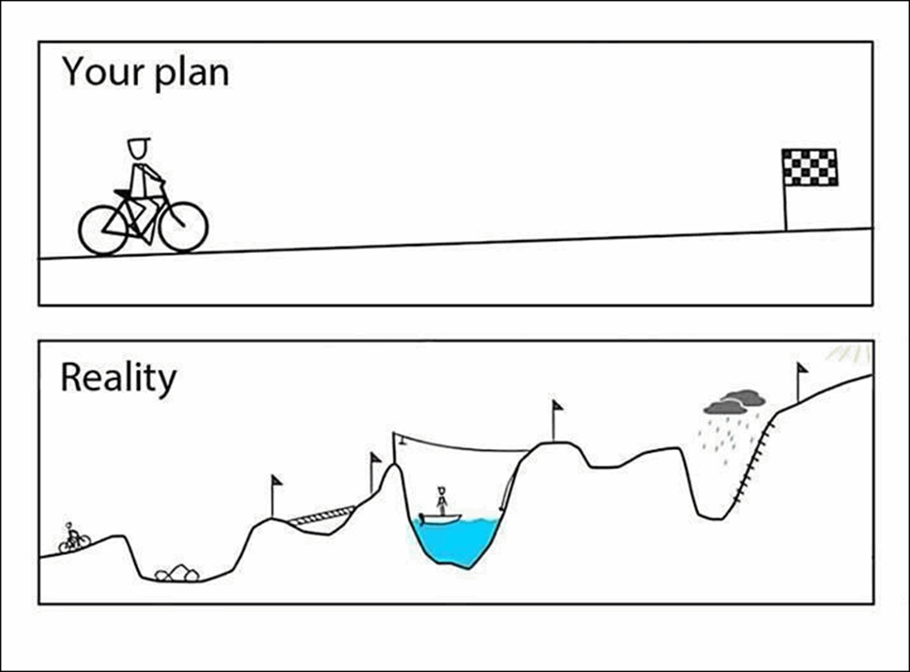
Long-Term Investing
Source: twitter account @ThinkingIP
Notes:
Is buy and hold really going to get you to the finish line in “reality?” Admittedly, it is possible for buy and hold to work out okay over very long periods of time if the assumptions about the long-term returns from the different components of the portfolio are somewhat correct. For example, consider an allocation that consists of 40% US equities, 20% International Equities, and 40% U.S. Fixed Income. This hypothetical client embraces this allocation and makes zero changes, other than periodic rebalances. Is it possible that this allocation produces a reasonable return for the client and generates the type of growth that they will need to build an adequate nest egg for retirement? Yes, it is absolutely possible. But, it is also possible that it doesn't. It is possible that the returns to one or more of these asset classes goes through a secular bear market that materially impairs the returns of the overall portfolio during the investor’s time horizon. An equally large, if not larger, risk to the buy and hold approach to asset allocation is if the investor will have the psychological fortitude to stay the course during the inevitable rough patches. What is his or her tolerance for pain? You probably won’t have to do too much to jog their memory about the type of pain that can be felt during secular bear markets in equities, but a brief review of the meager returns earned by fixed income in certain decades (60’s and 70’s for example) may be in order. The goal here is not to scare you to death about the risks of the financial markets, but just to make sure there is adequate respect for both the risks and the opportunities that are available in the financial markets.
An alternative approach to buy and hold is to tactically allocate among a broad range of asset classes using relative strength. A tactical approach to asset allocation simply acknowledges that asset classes go through secular bull and bear markets and that investors typically have a limited investment time horizon.

Slide 4
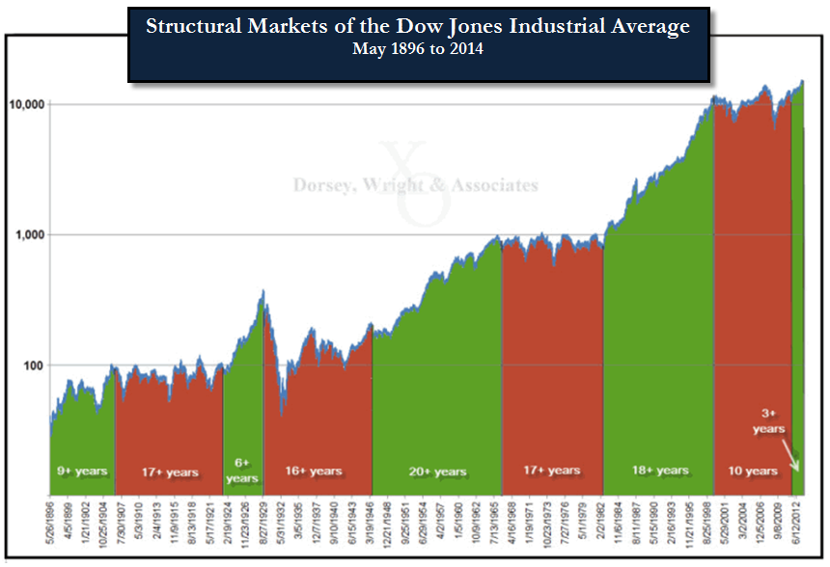
Notes:
A long-term perspective of the Dow Jones Industrial Average since 1896 reveals the reality that there are extended periods of time in which the US equity market will trend generally upwards, and also lengthy periods of time where the market will instead stagnate or move generally lower. There have been eight such alternating cycles since 1896, with each averaging 14 years in duration. Where an individual gets on the “investment train” can have a tremendous impact on portfolio returns overtime; however, even an individual fortunate enough to see two bull markets needs gameplan to navigate a 14 year stretch of a bear market. It is important to have at one's disposal strategies that are effective in both generally rising (bull) markets and falling (bear, or "fair") markets.
One methodology that has existed since the late-1800's and has been proven effective in both kinds of markets is that of the Point & Figure methodology. The first proponent of the methodology was Charles Dow, also the original editor of the Wall Street Journal. Charles Dow was a fundamentalist at heart, yet he appreciated the merits of recording price action and understanding the supply and demand relationship in any investment. The Point & Figure methodology has developed over the past 100+ years, but remains at its core a logical, organized means for recording the supply and demand relationship in any investment vehicle. By charting this price action in an organized manner, we hope to ascertain who is winning that battle, sellers or buyers, supply or demand. By having the ability to evaluate changes in the market we have taken the first step toward also becoming responsive to both bullish and bearish periods.

Slide 5

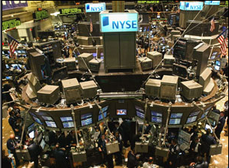
Basic Laws of Economics
We all understand the basic forces of supply and demand.
The same forces that affect prices in the supermarket also affect prices in the stock market.
Stocks, sectors, and asset classes move in and out of favor just like produce in the supermarket.
Notes:
We all understand the basic law of supply and demand; we have all experienced these forces at the supermarket. We know why in the winter tomatoes don’t taste very good, don’t have a very long shelf live, and are expensive. We inherently understand why there are lemonade stands in the summer and hot chocolate stands in the winter. Stocks, sectors and asset classes move in and out of favor just like produce in the supermarket.
5

Slide 6
ORIGINAL POINT & FIGURE CHART
Notes:
We have taken those prices and plotted into a graph as Charles Dow would have done back in the late 1800’s. Charles Dow was the first one to popularize the methodology. Charles Dow was the founder of the Wall Street Journal and he was a fundamentalist at heart but he also appreciated understanding the supply and demand relationship in anything he was going to buy. By putting the prices into a simple graph, Charles Dow could tell several things about this stock. First, every time it rallied, it rallied a little further than the last telling us that demand was getting stronger. At the same time, each time it pulled back, it did not pull back quite a far as the previous time. That tells us that supply is getting weaker. That is what we want to see in a stock we own – demand getting strong and supply getting weaker. Notice also the formation in blue. Think back to geometry class and what does this look like – a square? A trapezoid? It looks like a triangle pattern. You’ve just read your first Point & Figure chart. There are 11 patterns in all and the bullish triangle is one of them.
The Point & Figure chart is merely a logical, sensible, organized way of recording supply and demand in the marketplace. If we take a look at a series of prices for XYZ would you say that this chart is positive or negative? If you’re like me, it’s pretty hard to tell from the list of prices. It’s only when you plot them on a chart does it come to life.
6

Slide 7
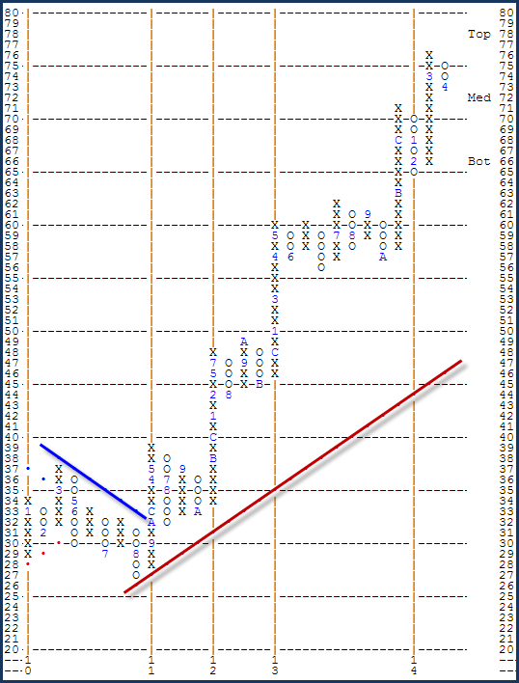

CVS Corporation (CVS)
Point & Figure Basics
Alternate columns of X’s and O’s
O’s = Price is falling
X’s = Price is rising
Minimum of 3 X’s or O’s in a column
Use daily high & low for charting price action
Time = First action in month use number (1 for January, etc.)
Notes:
This is a modern day Point & Figure chart of CVS Corporation. The numbers have moved to the vertical axis and the prices have been replaced with X’s and O’s. X’s represent demand O’s represent supply. You’ll notice that from May 2010 to December 2010, the stock was making lower X’s and lower O’s meaning that demand was getting weaker and supply was getting stronger. That started to change in December. Now we see that CVS is showing demand getting stronger by the X’s going higher and supply getting weaker by the O’s not pulling back as far each time. You’ll also notice two lines – red and blue. The Blue line is called the Bearish Resistance Line or I like to refer to it as I-95 South. As long as the stock is below the blue line, it’s “trend” is negative. Conversely, the red line is the Bullish Support Line or I-95 North. As long as the stock is above the red line, it’s “trend” is positive and I consider it a solid citizen.
7

Slide 8
Measuring Supply & Demand
Double Top
One column of X‘s exceeds
a previous column of X‘s.
Double Bottom
One column of O‘s exceeds
a previous column of O‘s.
39 |  | O
38 |  | O
37 |  | O
36 |  | O
35 |  | O |  |  | X
34 |  | O | X |  | X
33 |  | O | X | O | X
32 |  | O | X | O | X
31 |  | O |  | O
30
39
38 |  | X |  | X
37 |  | X | O | X | O
36 |  | X | O | X | O
35 |  | X | O |  | O
34 |  | X |  |  | O
33 |  | X
32 |  | X
31 |  | X
30 |  | X
Notes:
At the beginning of the presentation we talked about the fact the Point & Figure methodology is merely a way of measuring the supply and demand in the market place. In the first Leg of our stool, we want to get a composite pictures of whether stocks in general are controlled by supply or demand. You’ll remember from those beginning charts that Demand is represented by a column of X’s and supply is represented by a column of O’s.
So in the first column of O’s, supply took the stock down to 31. At that level, the buyers came in and carried the stock up to 34. At the 34 level the buyers dried up and then supply took control and carried the stock to 31 again. Once again at that level the buyers came in and pushed the stock up to 34. However, this time the buyers did not dry up at 34 and instead demand was strong enough to push the stock above the previous X and that gives us a double top buy signal at 35. We call it a double top because there are two columns of X’s. What do you think we would call it if there were three columns of X’s?
Conversely, in the chart on the right, at first demand carried it up to 38 and then supply or sellers came in and pushed it back to 35. There, the stock found buyers and pushed the price up to 38. Once again demand waned and supply took control. This time supply was strong enough to carry it not only down to 35 but to 34 and that was a double bottom sell signal. We call it a double bottom because the 35 level of support was tested twice and on the second test of support it was unable to hold.
All stocks must be on one of these two patterns. There can be variations, like a triple top or a quadruple bottom, but they all come down to these two patterns and because of this we can easily plot a chart called the NYSE Bullish Percent to ascertain whether demand or the Double Top is control of more stocks or supply and the Double Bottom has the upper hand.

Slide 9
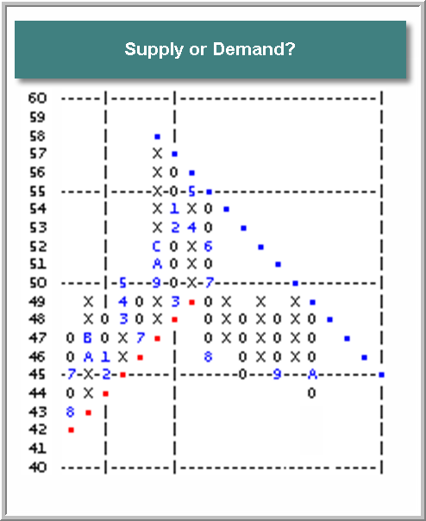
Chart Source: www.dorseywright.com
Notes:
Now that you have an understanding of how the Point & Figure chart works, let’s have a little test. Look at this chart and let me know whether supply or demand is in control? If you had this stock in your portfolio, would you want it in there or would you want to sell or hedge it?
Do you know what stock this is?

Slide 10
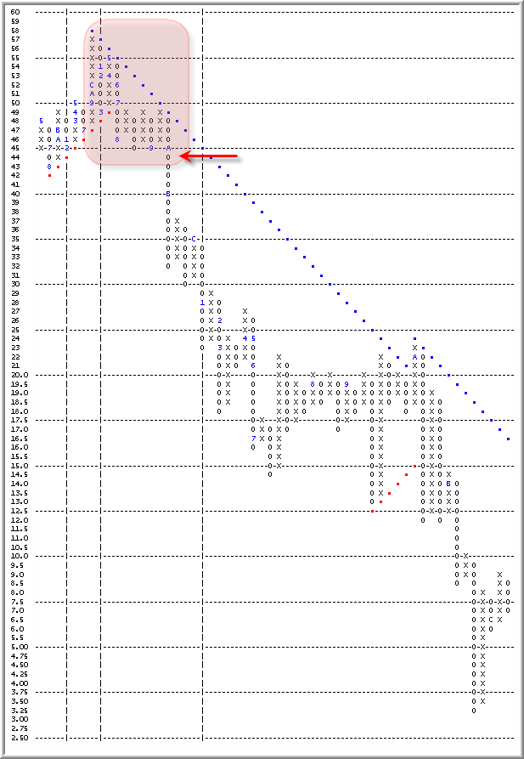
Citigroup (C)
Did the fundamental analysts learn from the 2000-2002 Technology Bubble?
The following is a quote from the February 9th New York Times article, “Why Analysts Keep Telling Investors to Buy”
“At the top of the market, they urged investors to buy or hold onto stocks about 95 percent of the time. When stocks stumbled, they stayed optimistic. Even in November, when credit froze, the economy stalled and financial markets tumbled to their lowest levels in a decade, analysts as a group rarely said sell. “
The example above is presented for illustrative purposes only and does not represent a past buy or sell recommendation
Chart Source: www.dorseywright.com
Notes:
It was Citigroup in October 2007. The stock had clearly started establishing a series of lower X’s – demand getting weaker; and lower Os – supply getting stronger. The Point & Figure chart was clearly signaling you sell or hedge Citigroup well before any of the news came out and well before the stock was down into the teens and single digits. We think back to the lack of sell recommendations during the Technology Bubble that burst in 2000-2002 and chastise the fundamental analysts for not having more sell ratings with new regulations designed to do just that but here we stand six years later and find that nothing much as changed according to the New York Time article “Why Analysts Keep Telling Investors to Buy.” I quote from that article, “At the top of the market, they urged investors to buy or hold onto stocks about 95 percent of the time. When stocks stumbled, they stayed optimistic. Even in November, when credit froze, the economy stalled and financial markets tumbled to their lowest levels in a decade, analysts as a group rarely said sell.” In fact, in January 2009 when the market suffered its worst January since 1950, there were a mere 5.9% of stocks possessing a sell rating according to Bloomberg. If the fundamentals in January 2009 don’t warrant sell ratings now, when will they?

Slide 11
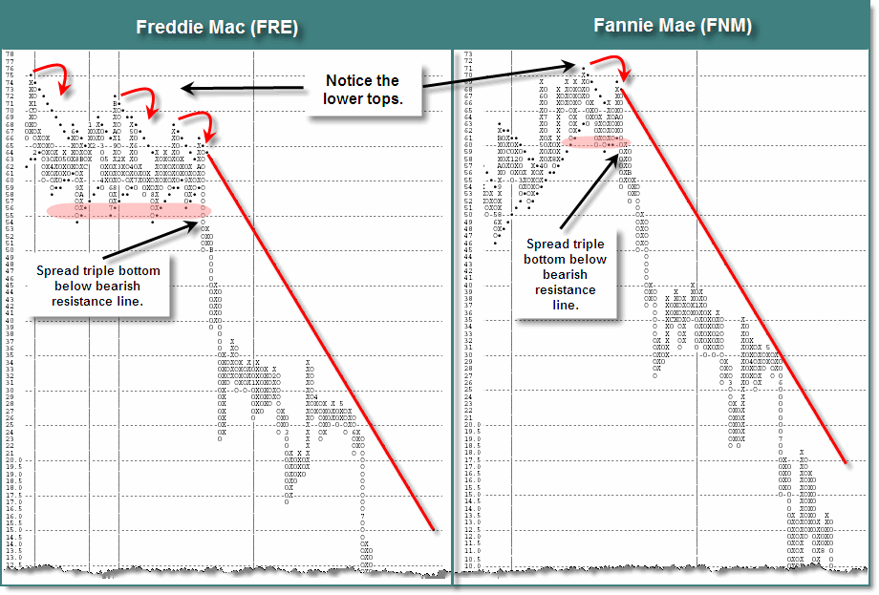
The example above is presented for illustrative purposes only and does not represent a past buy or sell recommendation
Chart Source: www.dorseywright.com
Notes:
But the Point & Figure charts didn’t just point to danger in Citigroup, it also pointed to danger in Freddie Mac and Fannie Mae…..

Slide 12
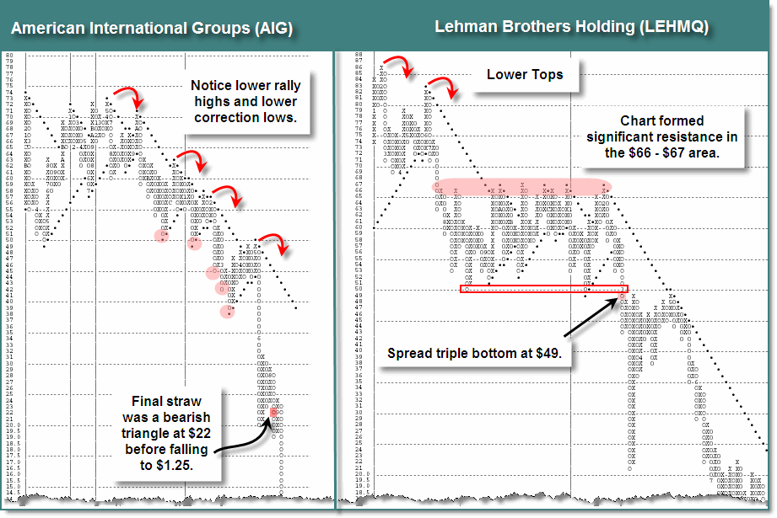
The example above is presented for illustrative purposes only and does not represent a past buy or sell recommendation
Chart Source: www.dorseywright.com
Notes:
And forewarned of supply taking control in AIG and Lehman Brothers….

Slide 13
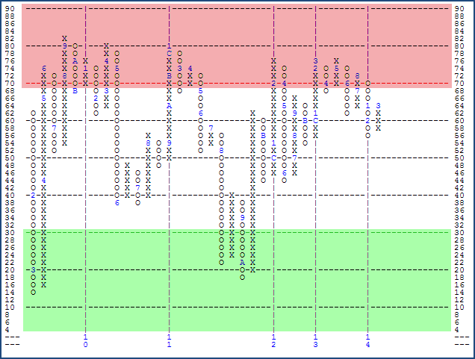
NYSE Bullish Percent
X’s = Offense – Wealth Accumulation
O’s = Defense – Wealth Preservation
Two Lines of Demarcation: 30% and 70%
Measures Risk in the Market
Does not have to move in tandem with the S&P 500 or the Dow Jones.
Chart Source: www.dorseywright.com
Notes:
The NYSE Bullish Percent Indicator, whose history goes back to 1955, is merely a measure of the percent of stocks being controlled by demand. At the end of everyday we go through all stocks on the NYSE and put them in two piles – the Double Top or Buy Pile and the Double Bottom or Sell Pile. Once that is completed, then we get a percentage reading of the percent of stocks on a Double Top or controlled by demand and plot that percentage on a grid which goes from 0% to 100%. When this indicator is in X’s it is rising and telling us that stocks are coming from the supply pile into the demand pile. Conversely, if the stock is falling and in O’s then it tells us that more stocks are moving from the buy pile into the sell pile and supply is gaining the upper hand.
We look at this chart as one of our main coaches telling us whether the offensive team is on the field or the defensive team is on the field. When the chart is in X’s the offensive team is on the field and we look to wealth accumulation strategies. When the chart is in a column of O’s, the defensive team is on the field and we look to wealth preservation strategies for the portfolio. There are two lines of demarcation letting us know our field position and the types of plays we should run. When this indicator gets down to the 30% level or lower it is in oversold territory and this is when the news media will be particularly negative. But remember, the markets look ahead 6 to 18 months. News headlines tell us what has happened. Conversely, the 70% level or higher is high risk. The availability of demand to push the market higher is severely limited. Typically this indicator gets to these extremes only once every 3 to 4 years. While 2008 was very active on this chart, it was just a reflection of the overall market volatility and on average this chart only changes 2.5 times a year from offensive to defense and vice versa.
There is one warning I must give you about this indicator and that is it will not necessarily move like the S&P 500 or the Dow Jones. Both of these indices give more votes to certain stocks either based upon how big the company is, capitalization in the case of the SPX, or price, as is the case with the DJIA. In the NYSE Bullish Percent, all stocks are created equal much like your portfolio is put together. That is why I find it a much better indicator to watch than the often quoted indices. You’ll never see this indicator quoted on CNBC.
13

Slide 14

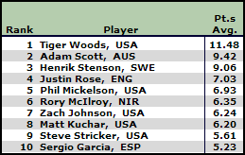


Relative Strength Calculation
All major sports have a ranking system. The Point & Figure Relative Strength tool is the ranking system we use for Stocks, ETF’s.
Daily Calculation:
Stock X 100 = Relative Strength
Index Reading
This reading is plotted on a Point & Figure chart which then tells us whether we can expect that stock or ETF to outperform or underperform the base index.
Notes:
In sports, when asked which teams or players are likely to perform better, those with more wins are routinely given higher probability of success. While there will be upsets along the way when picking winners in the sports world we want to focus on the winning teams. Teams that have good strategies, good players, and good coaches -the teams that are performing the best because they are most likely to continue to perform well. Why then do many investors try to pick stocks completely opposite to this?
If we apply this thought process – finding the strongest teams or areas - to the markets we’re talking about Relative Strength. Relative strength is merely a ranking system. Think about it like ranking your favorite sports team. Every sport has a ranking system – from golf to tennis to baseball to football to bowling – and they are all based upon the same philosophy. The better a player or team performs, the higher they go in the rankings. When they start to lose, they begin to fall in the rankings. We can affect the same type of ranking system based upon how an asset class performs. The more it outperforms something else, the stronger it is. When it begins to lose that strength, it falls in ranking. The actual relative strength calculation is very simple. We take one asset class like cash and divide by another asset class like US stocks. This number is then multiplied by hundred and then plotted on a Point & Figure chart like those you have just learned about.

Slide 15
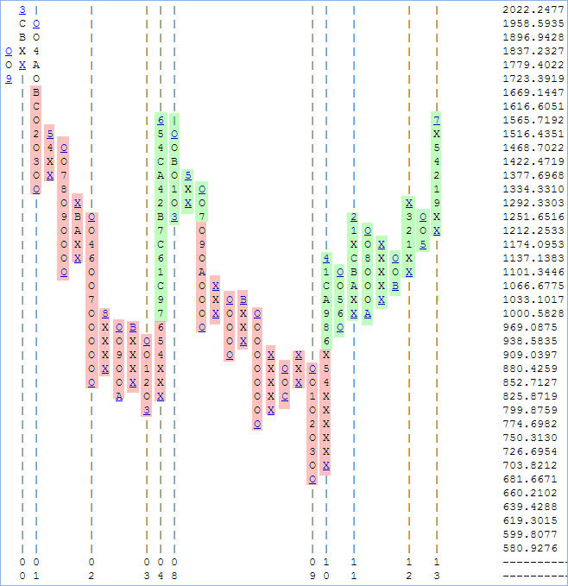
S&P 500 Index (SPX) vs. Barclays Aggregate Bond Index (AGG)
When RS Chart is on a buy signal, it suggests outperformance by the numerator (i.e. SPX).
Start Date | End Date | Signal | SPX | AGG
11/22/00 | 7/31/03 | Sell | - 25.11% | 23.16%
7/31/03 | 7/15/08 | Buy | 22.68% | 1.84%
7/15/08 | 6/5/09 | Sell | - 22.62% | - 0.69%
6/5/09 | 12/31/13 | Buy | 96.62% | 6.36%
Buy and hold SPX: | 39.78%
Buy and Hold AGG: | 32.48%
Switching: | 195.03%
RS Signal: Buy = Outperformance of SPX to Bonds
Sell = Underperformance of SPX to Bonds
The performance numbers above are pure price returns, based on the applicable index not inclusive of dividends, fees, or other expenses. Past performance not indicative of future results. Potential for profits accompanied by possibility of loss
This example is presented for illustrative purposes only, and does not represent a past or present recommendation.
Notes:
We have found RS to be one of the most robust and adaptable methods of security and asset class analysis. Despite truly being a very simplistic concept, RS has been proven time and time again to be a viable methodology for outperforming the market over time. Consider the relative strength chart here between the S&P 500 (SPX) and the Barclays Aggregate Bond Index (AGG). When the chart is on a buy signal (area of the chart highlighted in green) the chart favors owning stocks over bonds. On the other hand, when this chart is on a sell signal (area of the chart highlighted in red) the chart favors owning bonds over stocks. This chart has only given four signals over more than 13 years. A simple buy and hold of the S&P 500 from November 2000 through 2013 netted a return of 39.78% while the Barclays Aggregate Bond Index was up 32.48%. However, making a few adjustments to the portfolio along the way where we owned stocks when the chart was on buy signal and owned bonds when the charts was on a sell signal has netted a return of more than 195% over the same time.

Slide 16
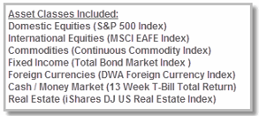
Performance Differential Among Asset Classes: 1990 - 2013
The differential numbers above are based on the price returns of the applicable non-investable index. Indexes do not include fees or transaction costs. Potential for profits is accompanied by possibility of loss. Past performance is not indicative of future results.
Notes:
Relative strength-based strategies (such as DALI) will tend to offer excess return over their benchmark more readily when the dispersion between the best and worst is very wide; yet the strategy will tend to suffer, or the benefit is muted, when the dispersion is narrower. 2010, 2011, and 2012 saw the performance differentials between asset classes narrow significantly, well below the historical average of 32.92%. In 2013 the difference was 36.54% between the best (US Equity) and the worst (Commodity).

Slide 17
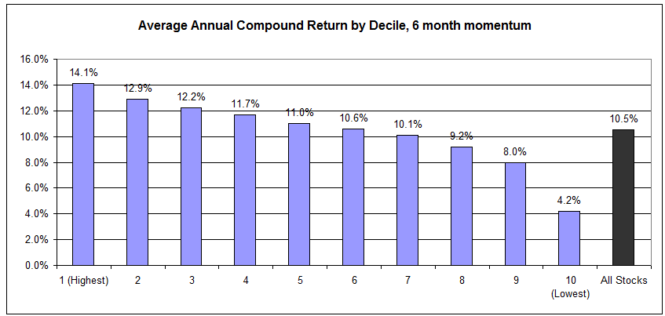
Why Relative Strength?
Source: What Works On Wall Street, 4th edition
Based on data compiled by James O’Shaughnessy and published in, “What Works on Wall Street”. Study period encompassed market data from 1926 to 2009, and the chart above shows that stocks with better 6-mo. momentum (i.e. good relative strength) generally continued to outperformed both the broad equity market, and weaker performance buckets.
The relative strength strategy is NOT a guarantee. There may be times where all investments and strategies are unfavorable and depreciate in value. Relative Strength is a measure of price momentum based on historical price activity. Relative Strength is not predictive and there is no assurance that forecasts based on relative strength can be relied upon.
Notes:
Over time relative strength has proven to be a driving factor in outperformance. A study conducted by James O’Shaughnessy, published in “What Works on Wall Street” found that “A $10,000 investment on December 31, 1926, in the decile of stocks from All Stocks with the best six-month price appreciation is worth $572,831,563 at the end of 2009, a compound return of 14.11 percent a year. This return dwarfed an investment in the All Stock universe, which turned $10,000 into $38,542,780 over the same period, an average annual compound return of 10.46 percent.” It is also important to point out that O'Shaughnessy found that this relative strength portfolio outperformed the benchmark in 68% of single-year returns, 79% of rolling 3-year returns, 87% of rolling 5-year returns, 95% of rolling 7-year returns, and 98% of rolling 10-year returns. Also, keep in mind that this is just a generic relative strength strategy based on a 6-month return factor with annual rebalances. His book also showed that using a 12-month relative strength factor also outperformed the benchmark with a compound return of 12.34 percent. And, just in case you were wondering, a strategy based on buying stocks with the worst 6-month returns and then holding for a year had an annualized return of 4.15 percent! As stated in the book, "If you're looking for a great way to underperform the market, look no further (than buying relative strength laggards)."

Slide 18
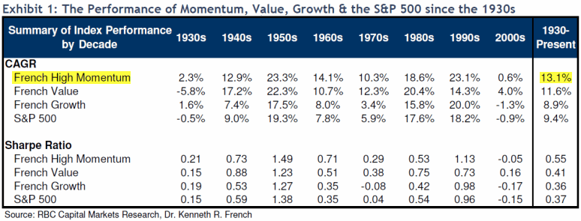
Relative Strength Research
High momentum (aka high relative strength) stocks have been proven to outperform Value, Blend, and Growth strategies over time.
The performance numbers are pure price returns, based on the applicable non-investable index. Indexes do not include fees or other transaction costs. Past performance not indicative of future results. Potential for profits accompanied by possibility of loss
The relative strength strategy is NOT a guarantee. There may be times where all investments and strategies are unfavorable and depreciate in value. Relative Strength is a measure of price momentum based on historical price activity. Relative Strength is not predictive and there is no assurance that forecasts based on relative strength can be relied upon.
18
Notes:
Here is another study conducted by RBC (Royal Bank of Canada) Capital Markets highlighting the fact that over time relative strength (or momentum) investing outperforms simply buying and holding.
18

Slide 19
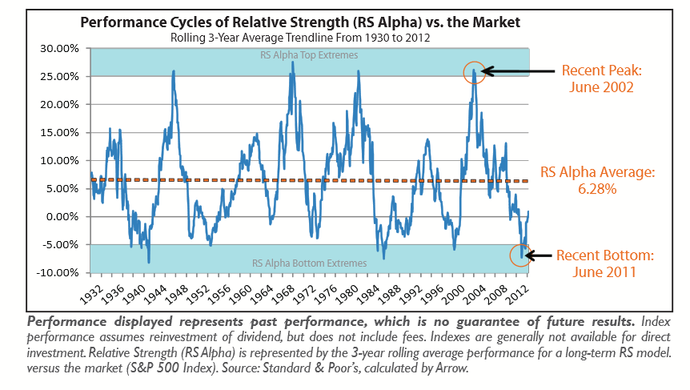
A Time for RS Strategies
Source: http://www.arrowfunds.com/files/DDF/Arrow_Insights_RS_Turns.pdf

Slide 20




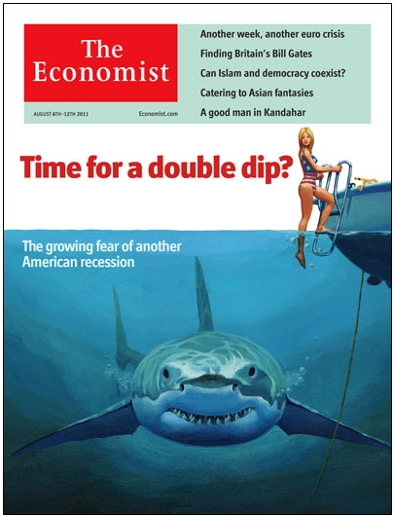

Magazine Covers
August – December 2011
Notes:
Some of the most effective (as well as popular) presentation tools that we have used over the years to explain the importance of having an investment game plan are magazine covers. You may recall that we often find that magazine covers typically present the most concise summary of investor psychology available. The average investor, as is perhaps best illustrated in various studies from Dalbar and others, over-corrects to changes in the market as they shift their 401(k) based generally on the feeling in their gut. Simply put, investors who are left to their own devices will, in sum, make emotional, irrational decisions and underperform over time as a result. They will buy when it is comfortable and sell when it is uncomfortable and that makes providing for a more comfortable lifestyle down the road a much longer road indeed.
Magazine covers typically help reinforce this modus operandi by providing a picture of the market's collective conscious. For instance, the psychological effects of buying the "top" of the market is a tough one to overcome especially when media headlines are so bullish. At the end of the day, the fear of buying the top of the market ultimately comes from the lack of sell discipline. It is for this reason that we find mainstream magazine covers so useful, they simply provide a reflection of what is comfortable and palatable to investors at any given time. While we find magazine covers extremely useful, it is not because their advice is helpful, but to the contrary it reminds us of what market psychology has categorized as "certainty" and then forces us to think in a different direction, to think about what possibilities exist on the other side of that trade.

Slide 21
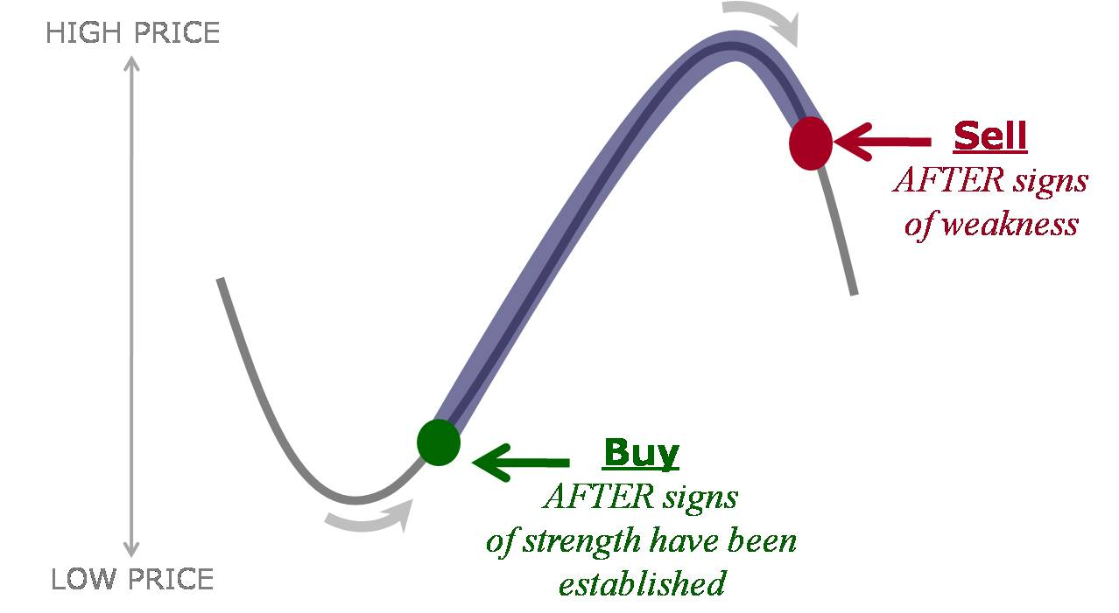

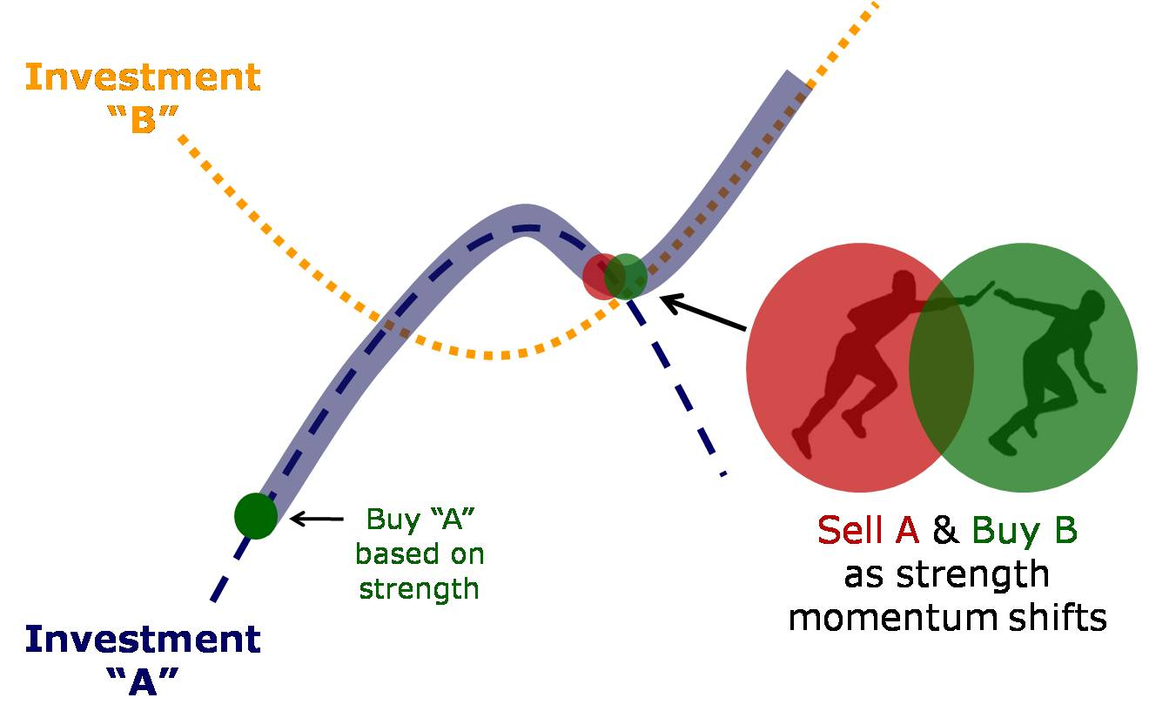
Big Picture Concepts: What is “Trend Following”?
Lesson:
Four “trends” can be better than one.
Source: Arrow Funds : www.arrowfunds.com
What Does “Trend Adaptation” Look Like?
Track & Field
400 meter World Record
Michael Johnson
43.18 seconds
4x100 meter World Record
Team Jamaica
36.84 seconds
Source: Arrow Funds : www.arrowfunds.com
Notes:
"Trend following" is neither predicting, nor ignoring, but rather taking enough information from the market to reasonably identify what the prevailing trends are today, and having a process designed to adapt to trends as they change tomorrow. One doesn't work particularly well without the other, as many trends don't pan out, but enough of them do in order to provide for a robust portfolio management approach over time. Trend following is much more listening to the market, than dictating to it. Trend following also pretty well sacrifices the prospect of getting in at bottoms, or out at tops, for any given investment. This is important, as the better the pros and cons of such an investment process are articulated, the better expectations have been established.
The reason a trend following, relative strength, approach can work is much the same as why a relay team of good athletes is generally faster than the world's absolute best at an event on their own.
Take the good ol' 400 meter footrace that is run at the Olympics every 4 years, and which gained a great deal of attention when Michael Johnson was in his prime (and his gold track cleats) and dominating that event. Johnson is still the world record holder with his time of 43.18 over 400 meters, set well over a decade ago. While none of the members of the Jamaican 4x100 meter relay team could make a reasonable stab at besting Johnson's 400 meter world record on their own, they did collectively demolish his time over the same distance. Four sprinters, passing a baton among them, covered that 400 meter distance significantly faster than Michael Johnson ever did.

Slide 22
Dynamic Asset Level Investing (D.A.L.I.)
The Dynamic Asset Level Investing (DALI) evaluates the supply and demand forces of asset classes, and ranks them from strongest to weakest based on their relative strength score.
Step One: Create Inventory
Step Two:
Relative Strength Analysis
US Equities
Int’l Equities
Commodities
Fixed Income
Foreign Currencies
Cash
Step Three:
Rank Each Asset Class
Optional
(Step Four)
Check RS vs. Cash & Trend
Notes:
Our primary tactical asset class rotation tool is built upon a series of relationships such as that of SPX vs. Cash. Our process begins with the construction of asset class “teams” that are constructed using ETFs that are specific to a certain asset class. US size and style funds comprise the US Equity “team,” while various Commodity Sectors like Precious Metals and Energy would make up the Commodity “team”. Every day the members of each team play against each member of the other teams, with net victories tallied in an effort to rank each asset class team by order of overall strength. The top ranked asset classes are those we want to emphasize within our current allocation.

Slide 23


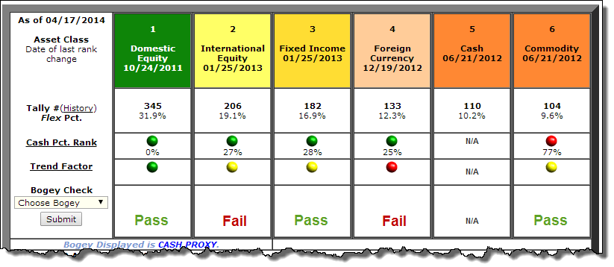


Current D.A.L.I. Process
Determine Allocation to each Asset Class through Relative Strength Analysis
Notes:
The core argument for a top-down investment process that is built upon DALI as the ranking engine for that process is that leadership asset classes are extremely important toward growing wealth for investors over time. Furthermore, you must be able to articulate that your investment compass is able to adapt in such a way that the brunt of bear markets in any major asset class are negotiated adequately. Your process needn't be "right" about all things, but it needs to be right about the things that matter over time, and this is primarily being on the proper side of major performance trends. If your process can't accomplish that in a repeatable manner, clients are probably better off following the strategic allocation mantra of owning a little of everything and hoping for the best

Slide 24
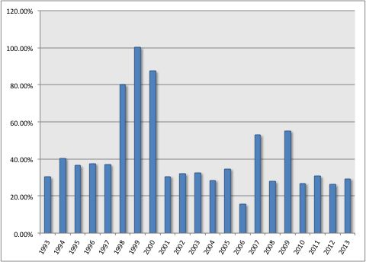
Sector Differentials
Dow Jones Macro Sectors: 1993 - 2013
Average Differential between the Best & Worst Performing Macro Sector is 41.57%
All Performance numbers are based on the performance of non-investable indexes. Investors cannot invest directly in an index. Indexes have no fees. Examples presented on this slide are for illustrative purposes only and do not represent past or present recommendations. Past performance not indicative of future results. Potential for profits accompanied by possibility of loss .

Slide 25
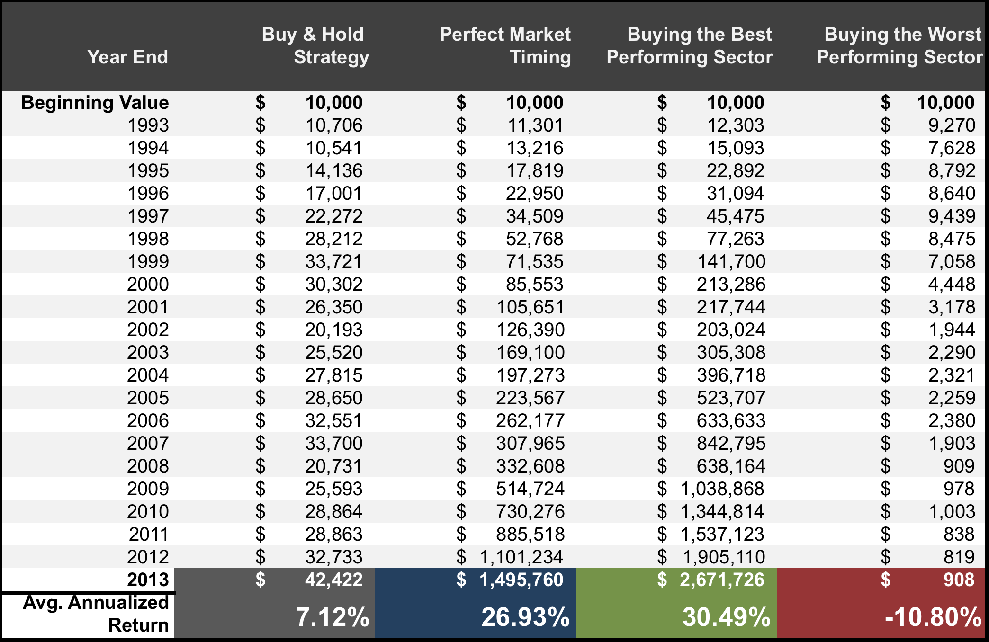
Sector Impact
All Performance numbers are based on the backtested performance of non-investable indexes. Investors cannot invest directly in an index. Indexes have no fees. Examples presented on this slide are for illustrative purposes only and do not represent past or present recommendations. Past performance not indicative of future results. Potential for profits accompanied by possibility of loss. Please see the final slide for important information regarding hypothetical backtested returns.

Slide 26



Reaching Your Destination
X
Int’l
Cash
Commodities
Fixed Income
Equity
Notes:
In order to be a successful investor, we don’t have to be perfect. What we do need to know is when wealth accumulation is the focus and when wealth preservation are the focus. Will we catch the exact top of the market to get out? No. Will we catch the exact bottom to get back in the market? No. Will there be times the portfolio is down? Absolutely. Will the portfolio be positioned to take advantage of major themes in leadership. Yes. The goal of these strategies is to help us navigate the financial waters – whether the seas are calm or choppy – so that one day we can arrive at our end destination. Those without a strategy for knowing when to be invested and when to wait on the sidelines until we get the ball back have a high probably of finding themselves shipwrecked on a deserted island. The small changes we make during the course are at first imperceptible but down the road as you are making your way toward your destination that same changes can make the difference in hitting your goal and missing.

Slide 27
The information contained herein has been prepared without regard to any particular investor’s investment objectives, financial situation, and needs. Accordingly, investors should not act on any recommendation (express or implied) or information in this material without obtaining specific advice from their financial advisors and should not rely on information herein as the primary basis for their investment decisions. Information contained herein is based on data obtained from recognized statistical services, issuer reports or communications, or other sources believed to be reliable (“information providers”). However, such information has not been verified by Dorsey, Wright & Associates, LLC (DWA) or the information provider and DWA and the information providers make no representations or warranties or take any responsibility as to the accuracy or completeness of any recommendation or information contained herein. DWA and the information provider accept no liability to the recipient whatsoever whether in contract, in tort, for negligence, or otherwise for any direct, indirect, consequential, or special loss of any kind arising out of the use of this document or its contents or of the recipient relying on any such recommendation or information (except insofar as any statutory liability cannot be excluded). Any statements nonfactual in nature constitute only current opinions, which are subject to change without notice. Neither the information nor any opinion expressed shall constitute an offer to sell or a solicitation or an offer to buy any securities, commodities or exchange traded products. This document does not purport to be complete description of the securities or commodities, markets or developments to which reference is made.
Unless otherwise stated, performance numbers are based on pure price returns, not inclusive of dividends, fees, or other expenses. Past performance is not indicative of future results. Potential for profits is accompanied by possibility of loss. You should consider this strategy’s investment objectives, risks, charges and expenses before investing. The examples and information presented do not take into consideration commissions, tax implications, or other transaction costs.
The material has been prepared or is distributed solely for information purposes and is not a solicitation or an offer to buy any security or instrument or to participate in any trading strategy.
Some performance information presented is the result of back-tested performance. Back-tested performance is hypothetical (it does not reflect trading in actual accounts) and is provided for informational purposes to illustrate the effects of the Dorsey Wright strategy during a specific period. The relative strength strategy is NOT a guarantee. There may be times where all investments and strategies are unfavorable and depreciate in value. Relative Strength is a measure of price momentum based on historical price activity. Relative Strength is not predictive and there is no assurance that forecasts based on relative strength can be relied upon.
Back-tested performance results have certain limitations. Such results do not represent the impact of material economic and market factors might have on an investment advisor’s decision making process if the advisor were actually managing client money. Back-testing performance also differs from actual performance because it is achieved through retroactive application of a model investment methodology designed with the benefit of hindsight. Dorsey, Wright & Associates believes the data used in the testing to be from credible, reliable sources, however; Dorsey, Wright & Associates makes no representation or warranties of any kind as to the accuracy of such data. All available data representing the full platform of investment options is used for testing purposes.

Slide 28
The information contained in this presentation has been provided by Dorsey, Wright & Associates, LLC (“DWA”). Railroad Street Wealth Management, LLC (“Railroad Street”), a registered investment advisor, obtained this presentation directly from DWA and has not altered its content. Railroad Street has not independently verified the information contained herein and makes no representations or warranties or take any responsibility as to the accuracy or completeness of the information contained herein.
This presentation is provided solely to gain an understanding of the investment philosophy and process that Railroad Street employs. DWA is a core input to the Railroad Street process. This presentation should not be considered investment advice nor a recommendation to purchase or sell any securities nor take any action. Railroad Street works directly with each Client to determine an investment strategy.
This presentation contains hypothetical and back-tested performance returns. These hypothetical values are for illustrative purposes only. Hypothetical returns have limitations in that they do not represent the performance of actual accounts and have the benefit of knowing how markets/securities have actually performed, which could have altered the model. Performance returns cannot be guaranteed and actual performance.

